Slide 1

Does the Age Gap Matter?
Andro Manukov
stat 448
Notes:
Does the age gap matter when it comes down to producing healthy babies?

Slide 2
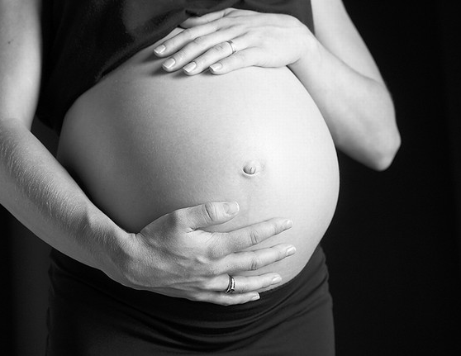
Motivation
We all know of the negative consequences of having a child later in life.
Is there any relationship between having a child with someone significantly older?
This Photo by Unknown Author is licensed under CC BY-ND
Notes:
We all know there are risks associated with women having children later in life, but does a large difference in age have any affect on the baby’s health?

Slide 3
Which Variables will be used?
Age Gap ~ abs(Mothers Age – Fathers Age)
Dbwtlbs ~ Weight of baby in pounds
OEGest_R3 ~ Premature or not
Age Gap Recode ~ 0 for age gap under 10, 1 for age gap between 10-15 years, 2 for age gap between 15-20 years, 3 for age gap greater than 20 years
Congenital anomaly bin ~ 1 if the baby was born with an anomaly, 0 if the baby was born without an anomaly
Notes:
The variables used in this analysis are Age Gap, DBWTLBS (birth weight), Premature or not, Age Gap Recode (to categorize age gaps) and a Congenital anomaly bin.

Slide 4
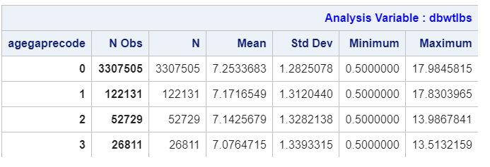
Initial observations
There is no real difference between the 4 categories, especially the mean and standard deviation
Notes:
As shown here, Theres only slight differences across age gaps when comparing the average and standard deviations of the baby’s weight.

Slide 5
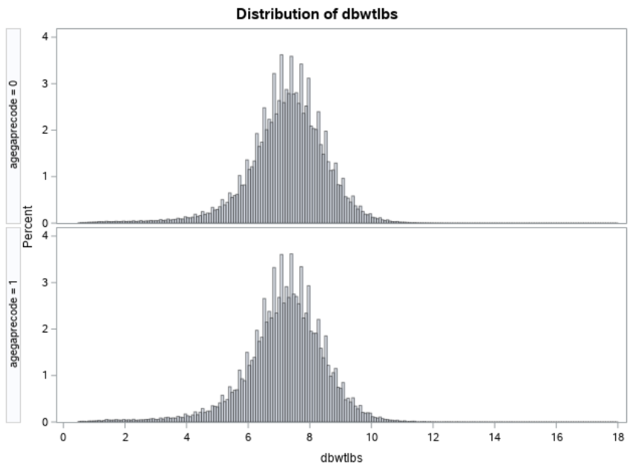
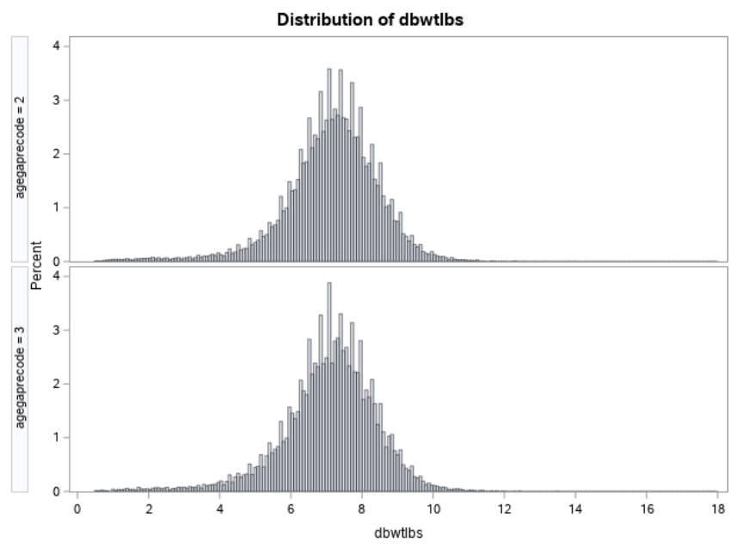
Initial Observations Continued
The Histograms between each age gap category seem to suggest that there is no real difference of baby weight among different age gaps.
Notes:
From an initial glance, the histograms also tend to suggest that birth weight is around the same, regardless of age gap.

Slide 6
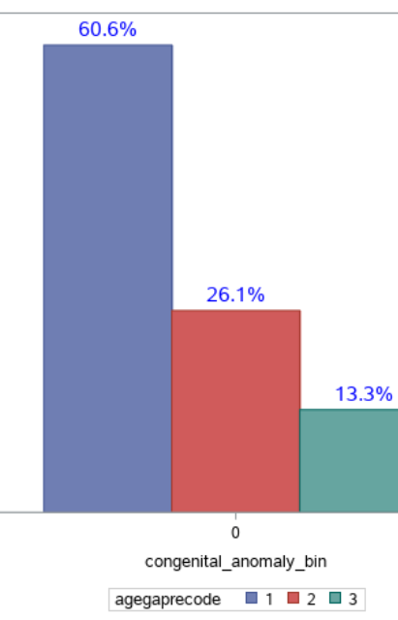
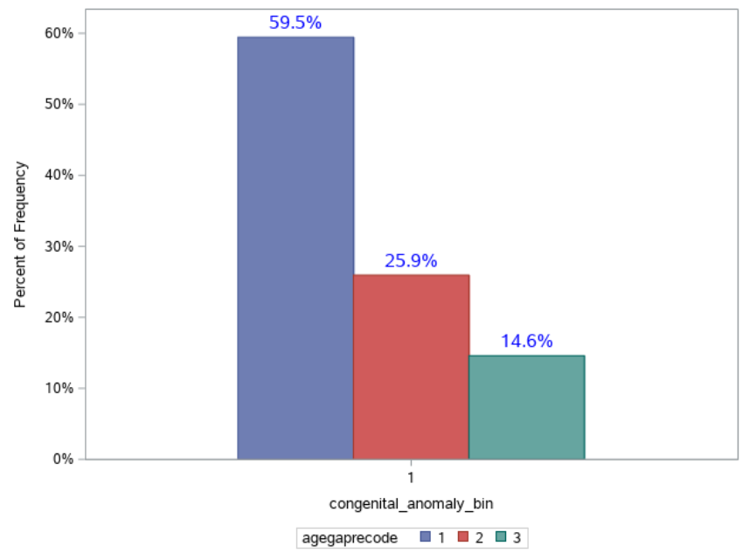
Congenital anomalies
These two bar graphs further show that there is not a noticeable relationship between congenital anomalies in different age gap groups.
If there was a relationship, the percentages would not be so closely related when comparing across bins
Notes:
A bar plot comparing congenital anomalies in different age groups also suggests that there is no real effect on anomalies. If there were then we could expect to see a large difference in percentages, especially in the 20 year age gap group.

Slide 7
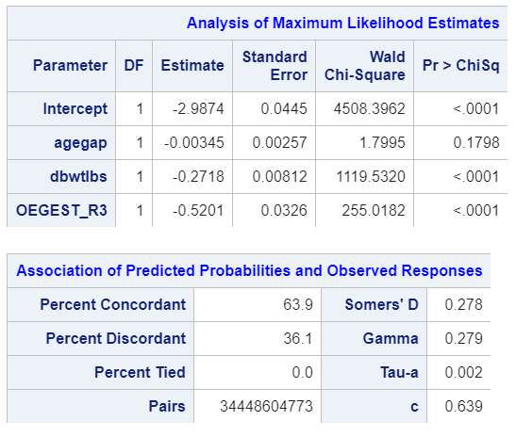
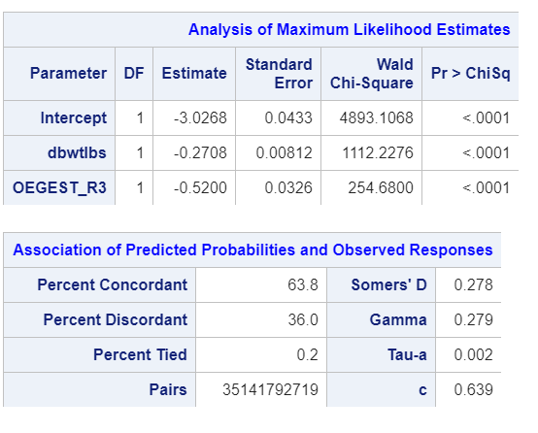
Can we use age gap in logistic regression to predict if a baby will have a congenital Anomaly?
To test this, I compared two models, one with agegap as a predictor along with weight and OEGEST_R3 and one without agegap but with weight and OEGEST_R3.
Both models had a c value of .64 meaning they are slightly better than chance but also signifying that the agegap variable is not effective in predicting if a baby will have a congenital anomaly.
Notes:
So, Can we use logistic regression and the age gap variable to predict if a baby will have a congenital anomaly. To test this, I compared two models, one with agegap as a predictor and one without. Both models had a C value of .64 so they were both better than chance but that also meant that age gap was not effective in predicting if a baby was going to have congenital anomaly.

Slide 8

Other interesting stuff
Another aspect to consider is if results would change if we split the data into two subsets based on which parent was older
This Photo by Unknown Author is licensed under CC BY-NC-ND
Notes:
Something to consider to help improve this analysis would be to split the dataset up into two, based of which parent is older.

Slide 9

Conclusion
Based on the previous findings, there doesn’t seem to be an association between baby birth weight/congenital anomalies and age gaps.
This means if you want to focus on your career or party it up for your young/mid age adult years, you can still find a younger partner to have healthy babies with.
This Photo by Unknown Author is licensed under CC BY-SA-NC
Notes:
Based on the previous findings, there doesn’t seem to be an association between baby birth weight/congenital anomalies and age gaps.
This means if you want to focus on your career or party it up for your mid adult years, you can still find a younger partner to have healthy babies with.

